Slide 1
Result-API
By Adams Adinatu

Slide 2
objectives
Result-API was created to:
To provide platform to upload results of students.
Parents should be able to check their wards results.

Slide 3
Result-API was created using the following tools
Express
Dotenv
Nodemon
Vs code
Nodejs
Thunder client

Slide 4
Folders and files
.env allows you to create environment variables.
Results.js
routes

Slide 5
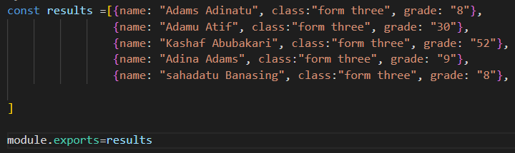
results

Slide 6
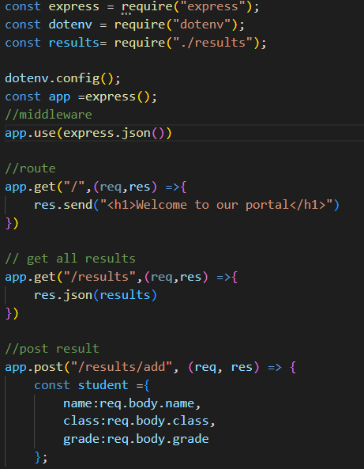
Entry file

